Slide 1


5th Episcopal District
Quadrennial Report
2016-2020

Slide 2
A Holy Nation!
Nehemiah 8:1-10 & I Peter 2:1-10
5th Episcopal District
Quadrennial Report
2016 – 2020
Bishop Clement W. Fugh, Presiding Bishop
Mrs. Alexia B. Fugh, Episcopal Supervisor

Slide 3


Slide 4
DEDICATION
This report is dedicated to the Presiding Elders, Pastors, Ministers, Lay, Women’s Missionary Society, Young Adults and Youth of the Fifth Episcopal District whose stewardship, love and labor it represents.

Slide 5
QUADRENNIAL CALENDAR
The challenge of the Fifth Episcopal District of the African Methodist Episcopal Church for the 2012-2020 Quadrennial is to walk in their destiny as The People of God – A Holy Nation. The challenge is not that they strive to be, but that they walk in its reality here and now.

Slide 6
QUADRENNIAL CALENDAR (con’t)
The call to holiness is not new to us. In fact, it is one of the pillars of Methodism. John Wesley and small circle associates at Oxford were called The Holy Club. Holiness is in our DNA.
To fully embrace holiness is not an overnight enterprise, so the entire Quadrennial is dedicated to that task.

Slide 7
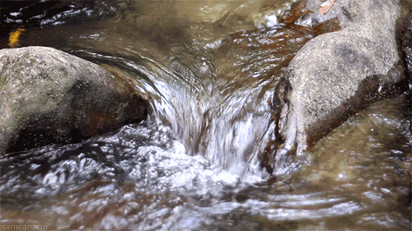
YEAR ONE:
SEASON OF LENT
2016-2017

Slide 8
SEASON OF LENT
Nehemiah 8:1-10 – 1 Peter 2:1-10
Emphasis: Purification and Penance
Theme: The Decalogue (Ten Commandments); the Beatitudes; Lent; Advent; Morality; Ethics; Forgiveness!
Color: Blue
Logo: Water (Throw all that stuff into the Sea of Forgetfulness, and then post a sign, “NO Fishing!”)

Slide 9
SEASON OF LENT (con’t)
“Forgiveness means letting go of stuff that you have been carrying for too long.” Forgiveness is not always about others, sometimes forgiveness is an act that we must perform in order for us to move on.

Slide 10
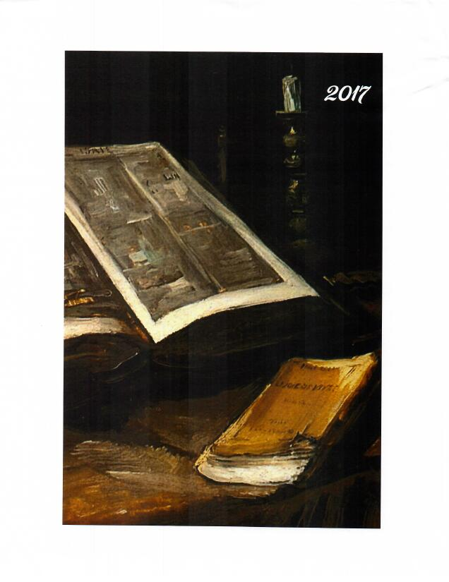
YEAR TWO:
SEASON OF EPIPHANY
2017-2018

Slide 11
SEASON OF EPIPHANY
II Timothy 2:15
Emphasis: Restoring the Temple Order – We achieve this through “training.”
Theme: Roles of Priest, Prophets, Pastors, Lagos (lay); Regard for the Holy – Holy House/Holy things/God’s people are Holy unto Him/Ministers of the Gospel are Holy unto Him!

Slide 12
SEASON OF EPIPHANY (con’t)
Color: White
Logo: Candle near an Open Bible
(“Study to show thyself approved unto God, a workman that needs not to be ashamed…”
II Timothy 2:15)

Slide 13
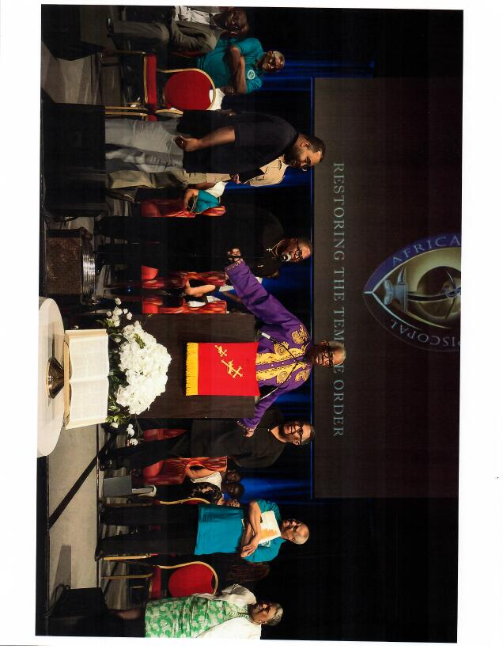

Slide 14
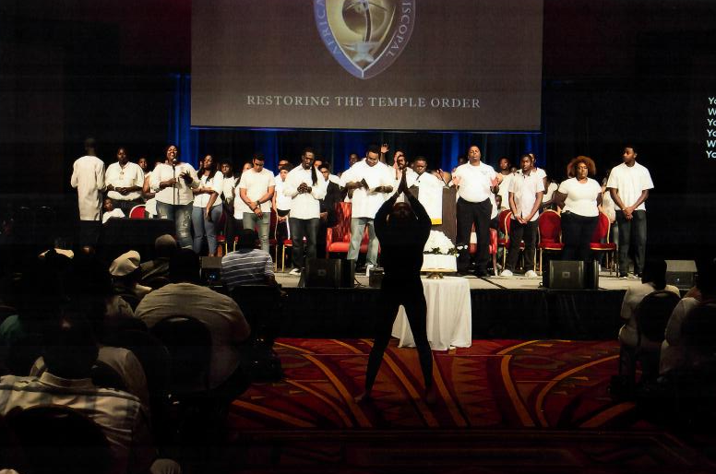
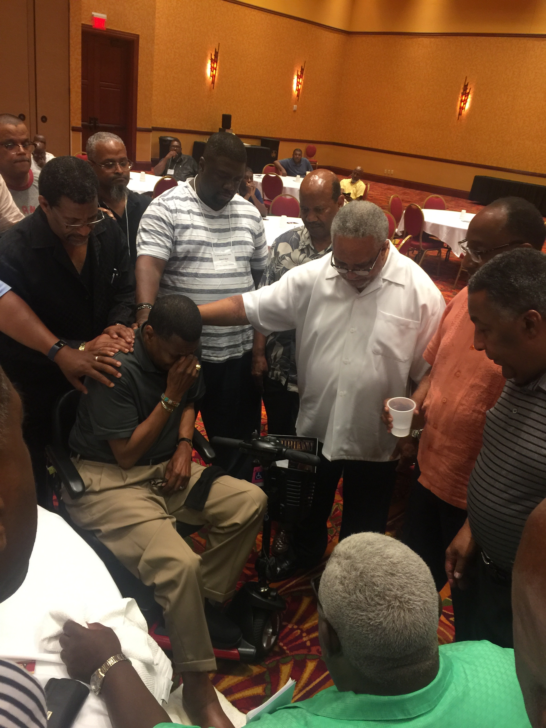
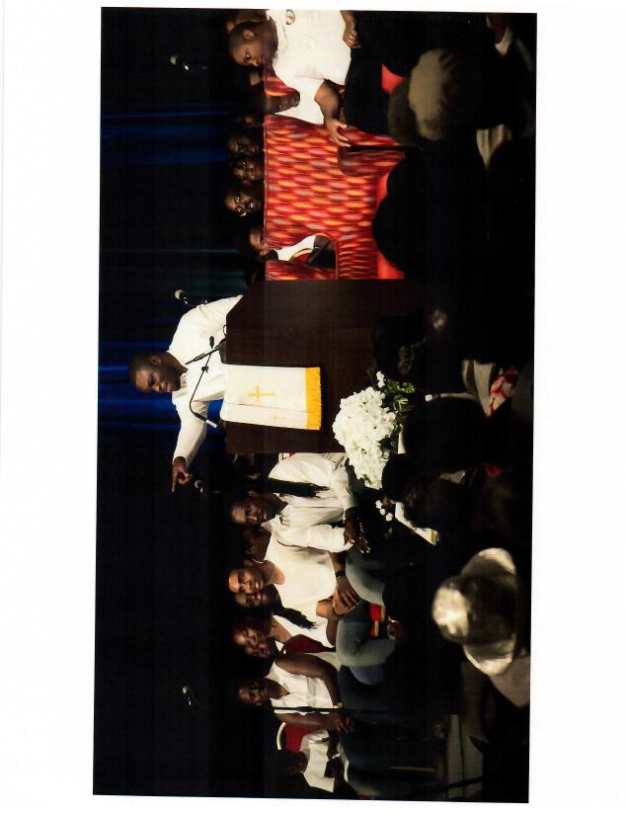

Slide 15

YEAR THREE:
SEASON OF PENTECOST
2018-2019

Slide 16
SEASON OF PENTECOST
St. John 20:19-22 & Acts 2:1-21
Emphasis: Evangelism / rekindling the fire of the Spirit
Theme: Paul’s Missionary Journeys; Seeking the lost; Intentional Evangelism
Color: Red
Logo: Flaming Dove

Slide 17
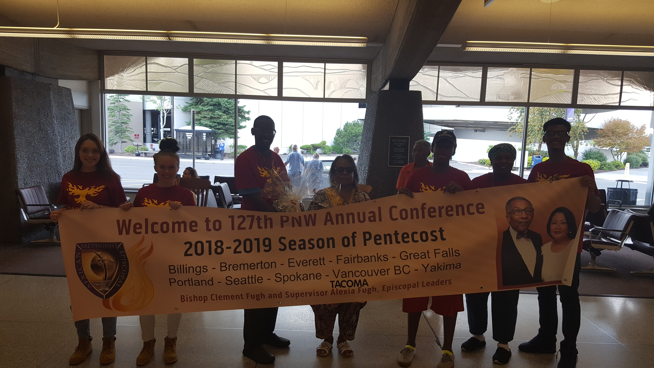

Slide 18
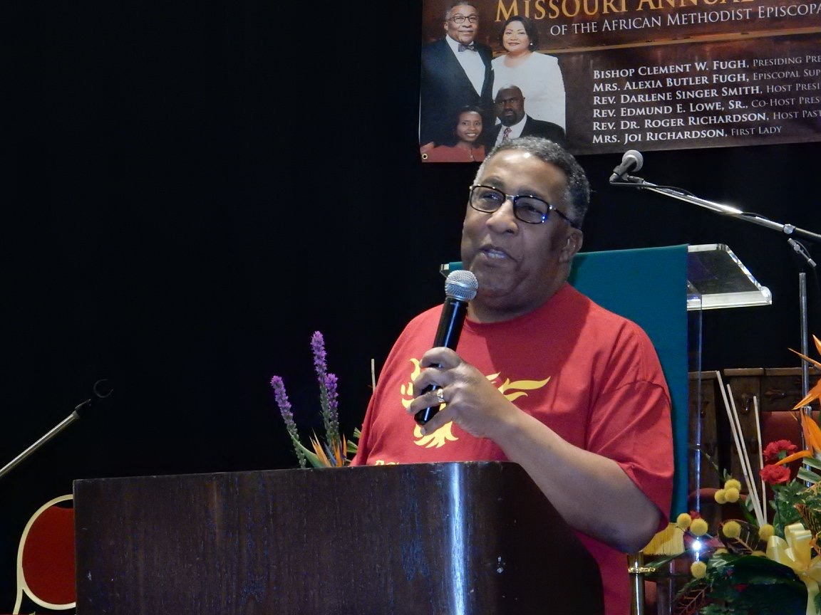
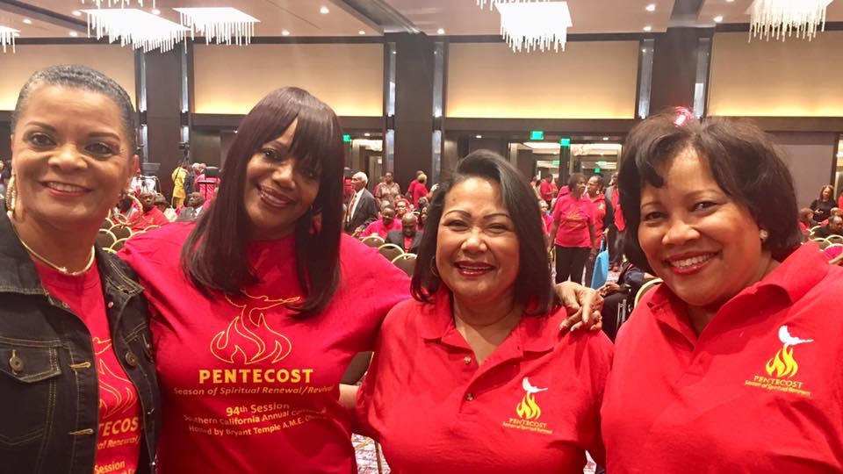
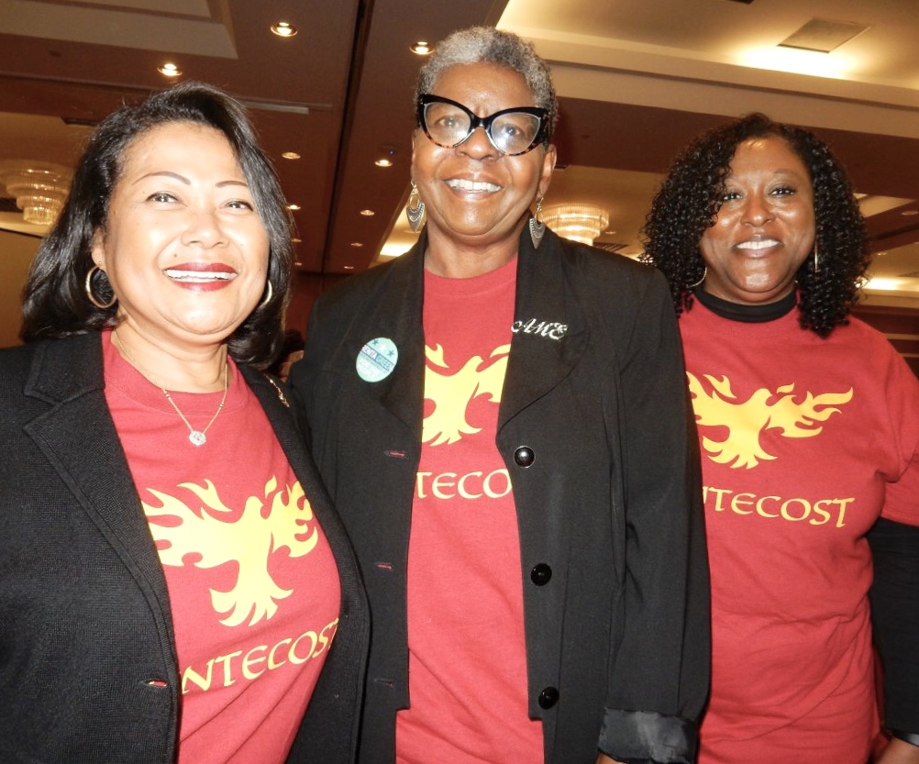
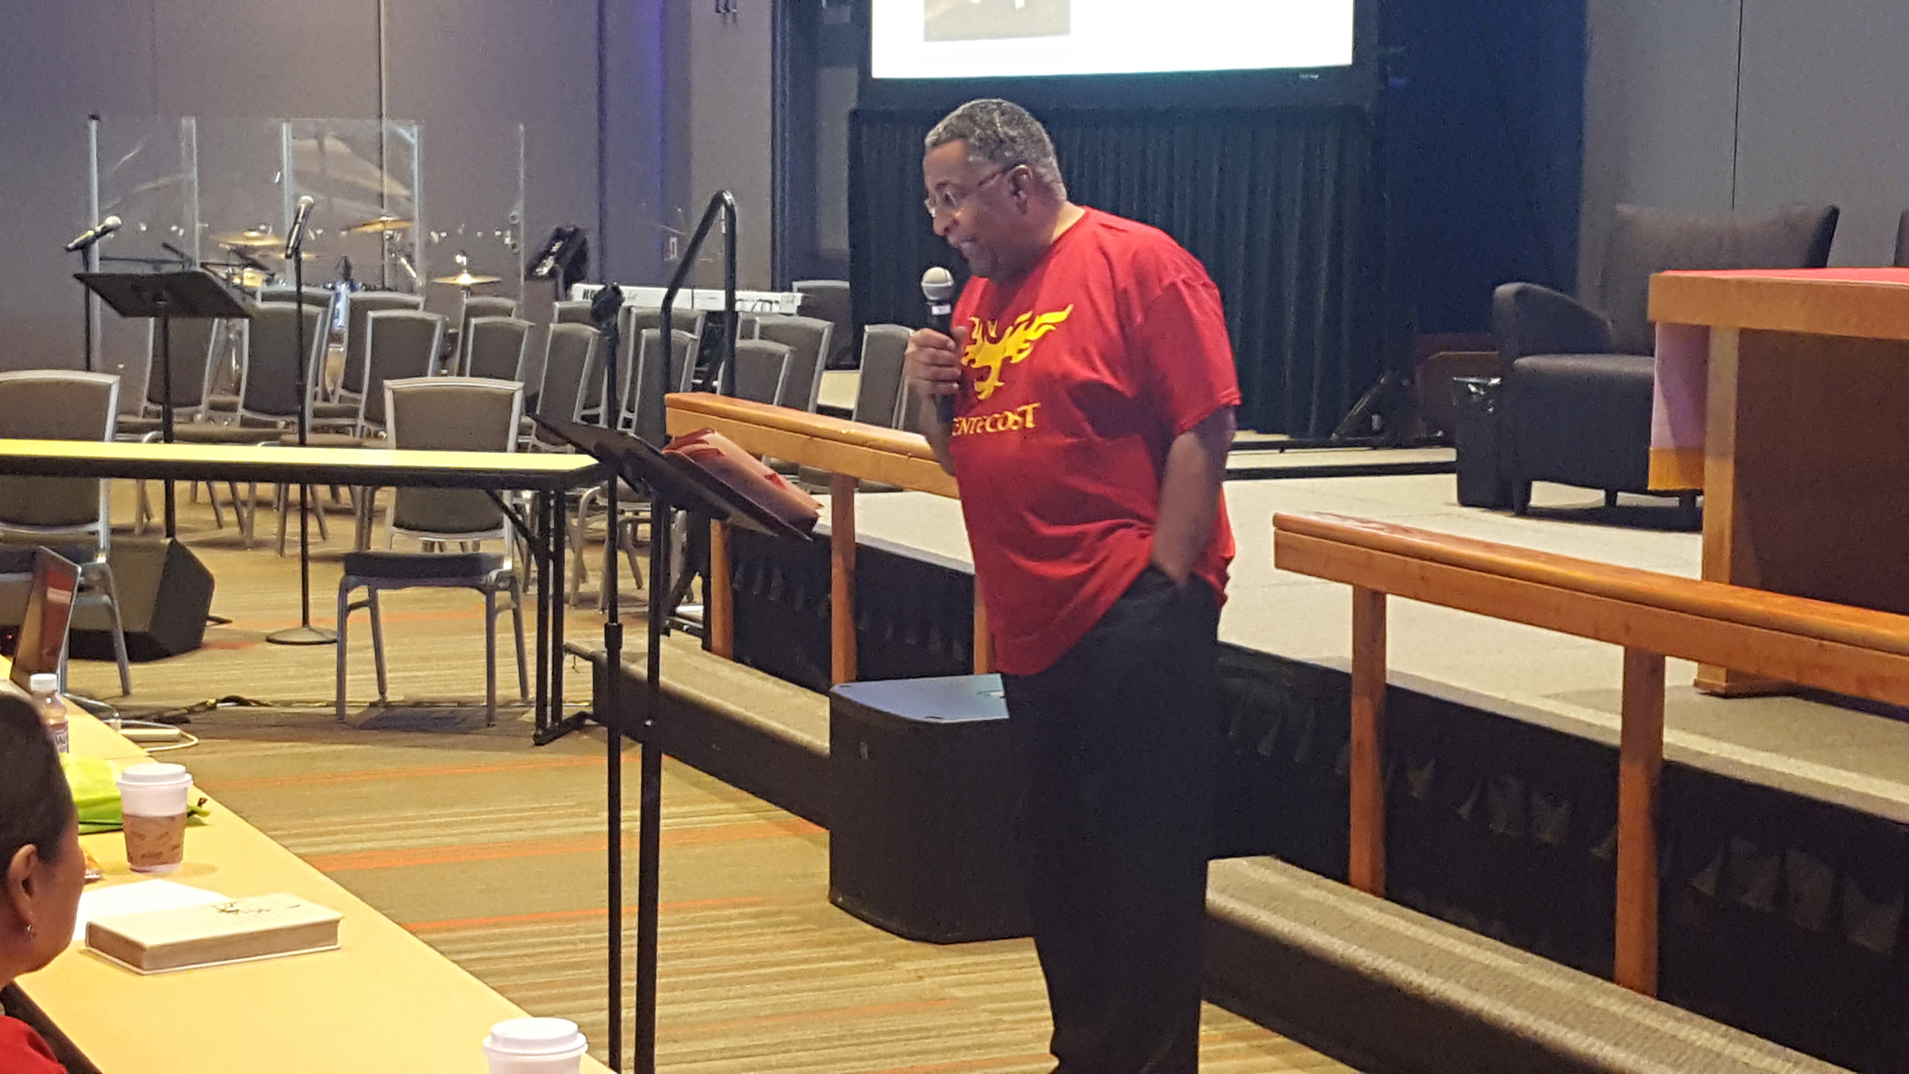

Slide 19
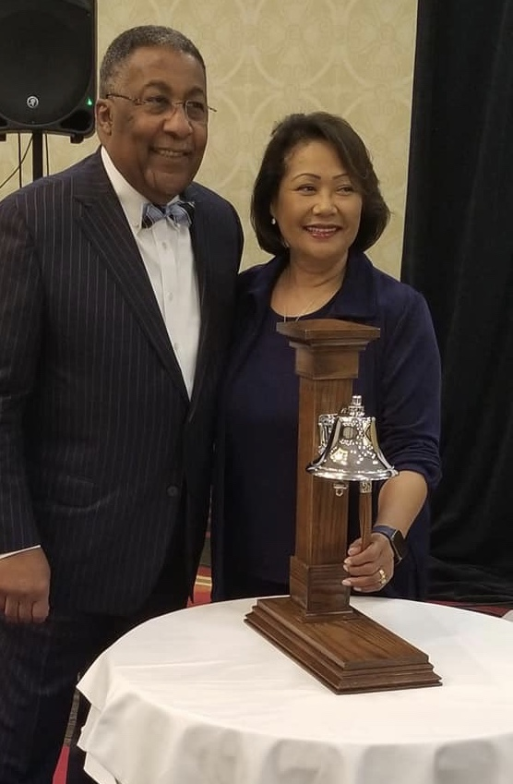

Ring the bell for Souls SAVED!!!

Slide 20

YEAR FOUR
SEASON OF KINGDOMTIDE
(Ordinary Time)
2019-2020

Slide 21
SEASON OF KINGDOMTIDE (Ordinary Time)
Psalm 126:6 & St. Matthew 13:10-17
Emphasis: Ministry in the local context
Themes: Care of the local congregations; Edifice; Community; Mission; Advocate for something / someone.
“Latch onto a cause that has eternity in it and let it lift you.”
(The Late Bishop Howard Thomas Primm)

Slide 22
SEASON OF KINGDOMTIDE (Ordinary Time) (con’t)
Psalm 126:6 & St. Matthew 13:10-17
Color: Green
Logo: Butterfly

Slide 23
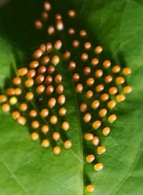
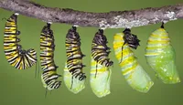
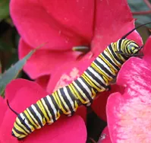
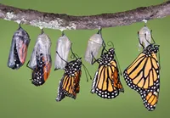
BUTTERFLY METAMORPHOSIS STAGES
*Picture Reference: https://www.thebutterflysite.com/life-cycle.shtml
First Stage:
The Egg
Third Stage:
The Pupa (Chrysalis)
Second Stage:
The Larva (Caterpillar)
Fourth Stage:
The Adult Butterfly

Slide 24
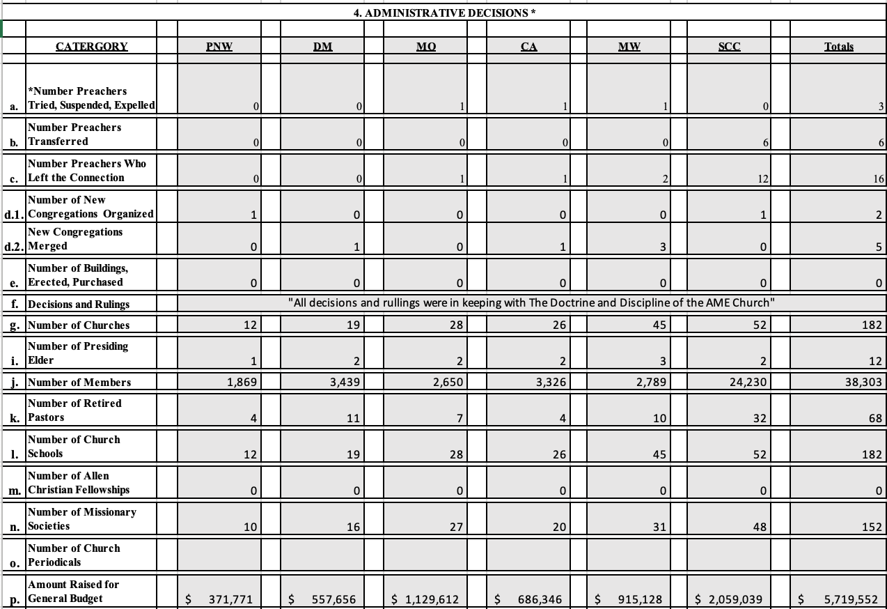
Administrative Decisions

Slide 25
Administrative Decision Notes
a. Number Preachers Tried, Suspended and/or
Expelled
Missouri (MO) 1 Rev. Peter Johnson (IE)
California (CA)j 1 Rev. Mark Anthony Epting (ID)
Midwest (MW) 1 Rev. Bonnie Williams (IE)
c. Number Preachers Who Left the Connection
Missouri (MO) 1 Rev. Terence Small (ID)
California (CA)j 1 Rev. Donnie Carter (IE)
Midwest (MW) 2 Rev. Joseph Nixon (IE)
Rev. Keith Cordier Sr. (IE)
c. Number Preachers Who Left the Connection (con’t)
Southern California (SCC) 12
Rev. Robin Allen (IE) Rev. Carolyn Brown (IE)
Rev. Edgar Jackson (IE) Rev. Joanne LoveJoy (IE)
Rev. Josephine Mills (IE) Rev. Linda Parker (IE)
Rev. Janeen Robinson (IE) Rev. Carlton V. Rickman (IE)
Rev. Dorothy Pollard (IE) Rev. Cynthia L. Pitts (IE)
Rev. George Peoples (ID) Rev. April Jackson (ID)

Slide 26
Administrative Decision Notes (con’t)
d. Number of New Congregations Organized and/or Merged
Organized:
Pacific Northwest (PNW) 1 Fountain Chapel, British Columbia , Canada
Southern California (SCC) 1 Hale Ho’Onani AME Fellowship Mission, HI
Merged:
Desert Mountain (DM) 1 Victory/New St. John – Victory
California (CA)j 1 St. Paul, Vallejo / Genesis – New Beginnings
Midwest (MW) 3 St. Luke’s, KCMO / Historic Allen, KCMO – Allen Chapel
St. John, KCMO / Allen Chapel, KCMO – Allen/St. John
Cain Grant / Ward Chapel, KCMO – Ward Chapel/Cain Grant

Slide 27
THANK YOU!

