Slide 1

51st Quadrennial Session of the
General Conference
Orlando Hybrid (Modified)
July 6-10, 2021
Two Cities…One Church

Slide 2
General Conference Dates
The 51st Quadrennial Session of the General Conference will open July 6, 2021 and close July 10, 2021.
The Connectional Lay Biennial will open the morning of July 11, 2021 and close the afternoon of July 12, 2021.
The General Conference will utilize the “Orlando Hybrid” model as previously presented with one modification – expand to two cities – Orlando, Florida and South Africa (city TBD).

Slide 3
What is the Orlando Hybrid?
The “Orlando Hybrid” is the meeting design we will implement for the 51st Quadrennial session of the General Conference. Essentially, we will decentralize the convention so rather than meeting as one large group in one large room we will meet by delegation in smaller rooms and locations. Each room and location will be connected virtually to view the General Conference proceedings. Within each delegation meeting room, delegates will be able to:
Utilize a speaker queue to be allowed to address the General Conference
Address the General Conference in real time
Vote in real time

Slide 4
Why the Orlando Hybrid?
With the current state of the Covid-19 pandemic, the Planning Team was tasked with providing options on how to best hold an in- person General Conference in the safest manner possible. Our plan was developed and is presented with the following goals in mind:
Provide an opportunity for a safe gathering to conduct the necessary business following CDC, FL Department of Health and local government guidance.
Reduce the size of crowds gathered at any one time in any place or space to allow for physical and social distancing
Institute CDC recommended measures to help control the possibility of an outbreak and minimize impact if one should occur
Protect the AME Church and its membership, reduce liability and financial loss

Slide 5
Orlando Hybrid Modification – Two Cities
Due to international travel concerns, we are proposing the following modification to the Orlando
Hybrid model:
Orlando, FL
AME Leadership, delegates, alternates and observers from Districts 1-13 and the 16th District will travel to Orlando.
General session room
14 delegation rooms (not to exceed 250 people)
Chaplains meeting room
Paid Observer meeting room(s)
South Africa (City TBD)
AME Leadership, delegates and alternates from Districts 14, 15, 17-20 will travel to a hybrid site in South Africa.
One meeting room for 6 delegations (not to exceed 250 people)

Slide 6
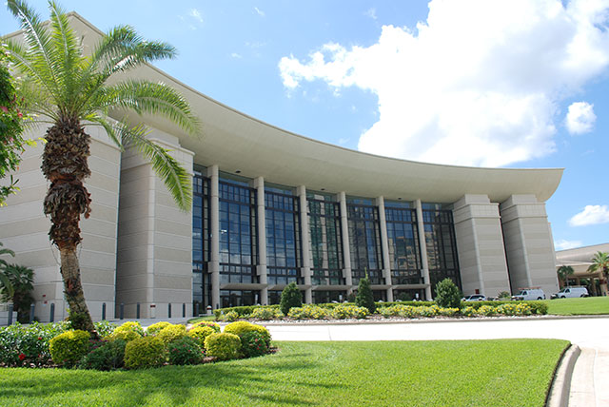
Orlando Hybrid - General Sessions
General Sessions will take place in the Orange County Convention Center (OCCC) West Hall A2. Only the following individuals will be allowed in the General Session Meeting Hall:
Bishops and Supervisors
General Officers and General Officer Spouses
Connectional Officers
Judicial Council
Board of Incorporators
College Presidents/Deans
CLO & WMS Delegates
VIP’s
Other Program Participants

Slide 7
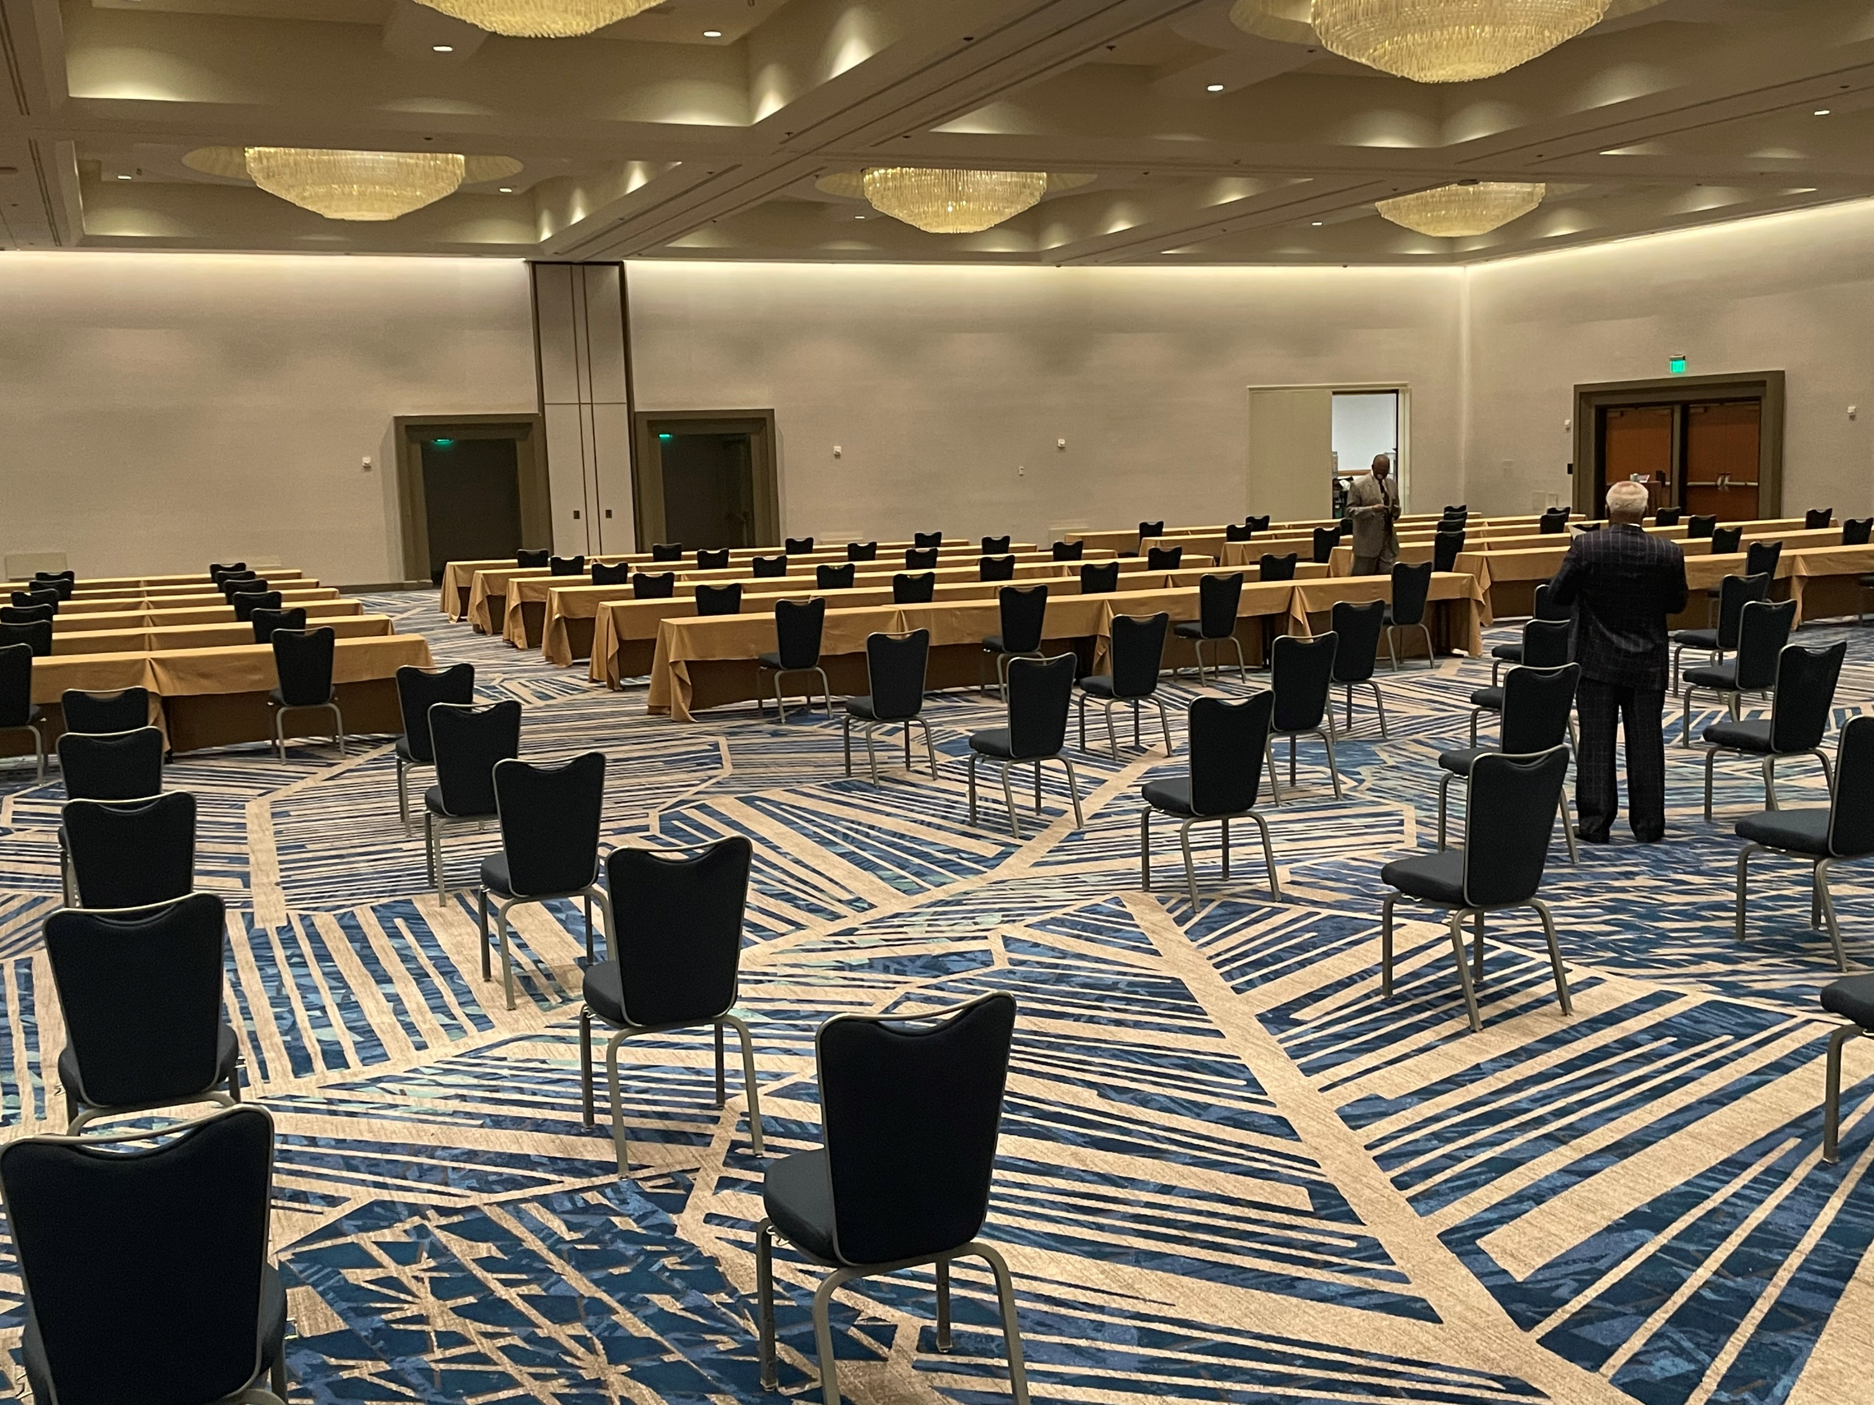
Orlando Hybrid - Delegation Meeting Room (DMR)
District delegates/alternates and Chaplains will have a meeting room in either their hotel or the convention center. In each room:
Seating at 50% capacity, delegates will be seated at assigned classroom tables spaced to accommodate 1 per 6-foot table
Alternates will be seated in assigned chairs behind the delegation spaced 6 feet apart
Only Delegates, Alternates and District leadership will be allowed in the DMR
Temperature & badge checks will happen daily
Rooms will be cleaned/disinfected regularly during scheduled breaks

Slide 8
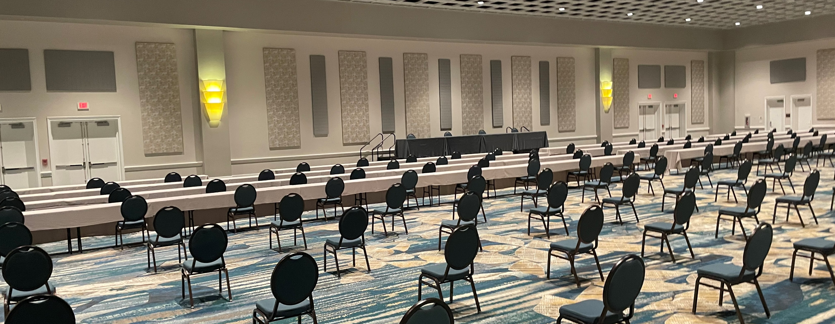
Sample set for Delegation Meeting Room (DMR)
Delegates will be seated at the classroom tables and alternates will be seated in chairs behind the delegation.

Slide 9
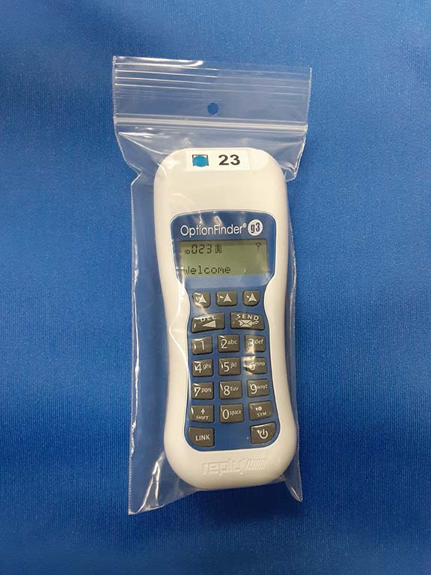
Orlando Hybrid – DMR Equipment
The following equipment will be in each DMR to provide the capacity to view the sessions, utilize a speaker queue to address the General Conference and vote in real time:
Screen & projector (multiple screens will be needed in larger rooms) to view proceedings
Two Computers – one to receive the signal, one to send a signal
Webcam to be seen when broadcasting
Sound system & microphone
Speaker Queue iPad
Voting keypads (individually packaged)
All equipment will be cleaned and disinfected regularly.

Slide 10

Orlando Hybrid – Mobile App
Delegates will access all legislation, reports and other materials via a secure section on the Mobile App.
Individuals will access the App on their own devices. We recommend downloading the App prior to arrival.
Observers will have access to the agenda and other general information on the App.
The App will be the best source for up-to-date information while on-site.

Slide 11
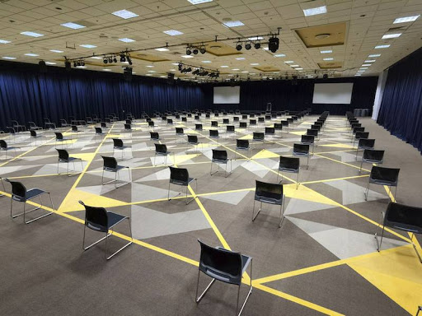
Orlando Hybrid – Paid Observer Meeting Room (POMR)
Paid Observers on-site will be seated in a separate meeting room. They will view the proceedings via a live feed from the General Session.
Seats will be physically and socially distanced.
Observers will be seated in assigned seats.(Same households will be allowed to sit together.)
Temperature checks and badges required to enter the Paid Observer Meeting Room as well.

Slide 12
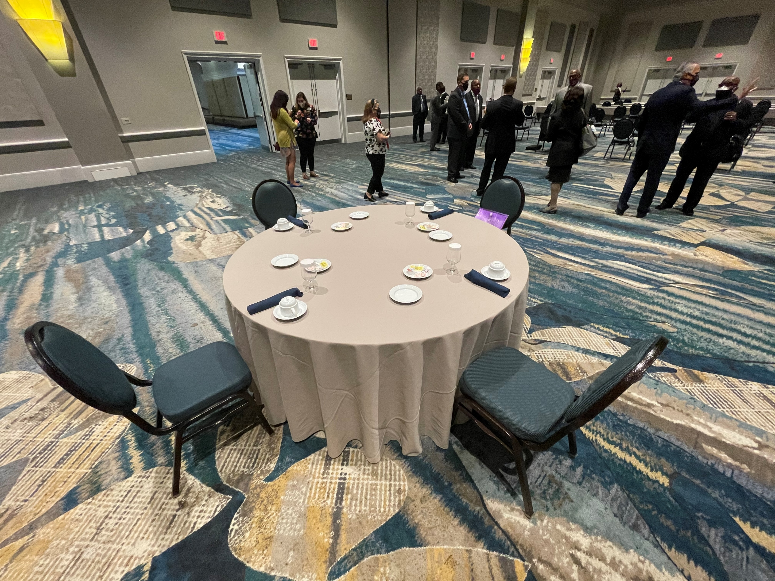
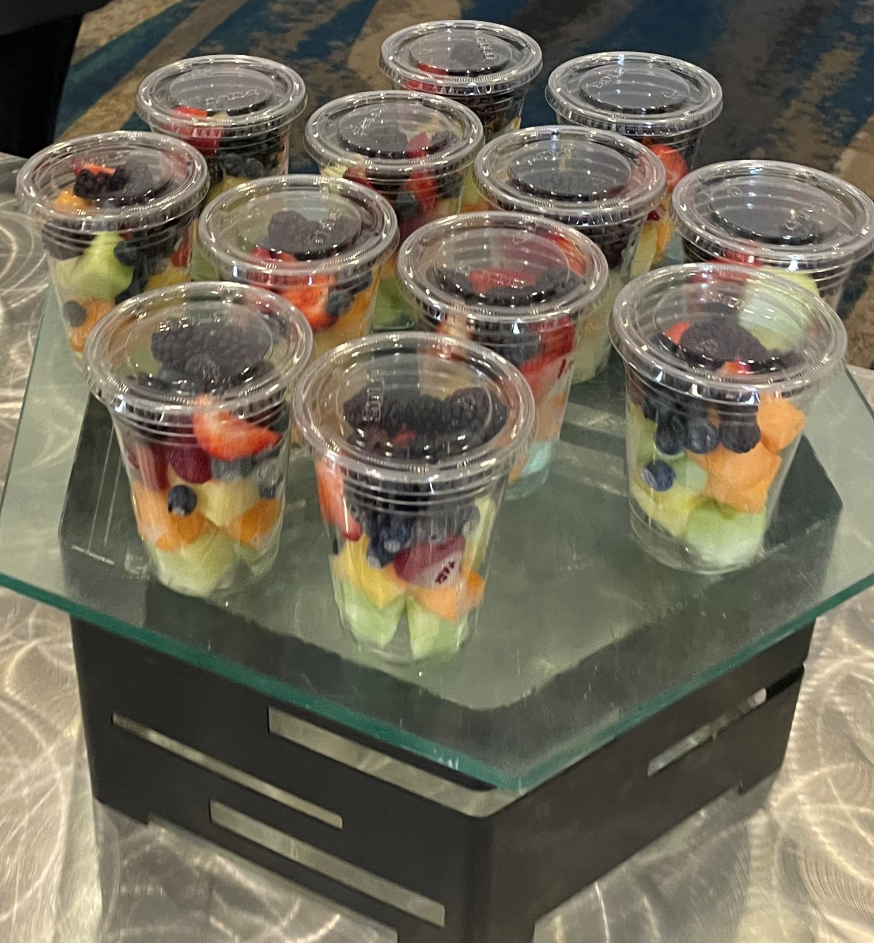
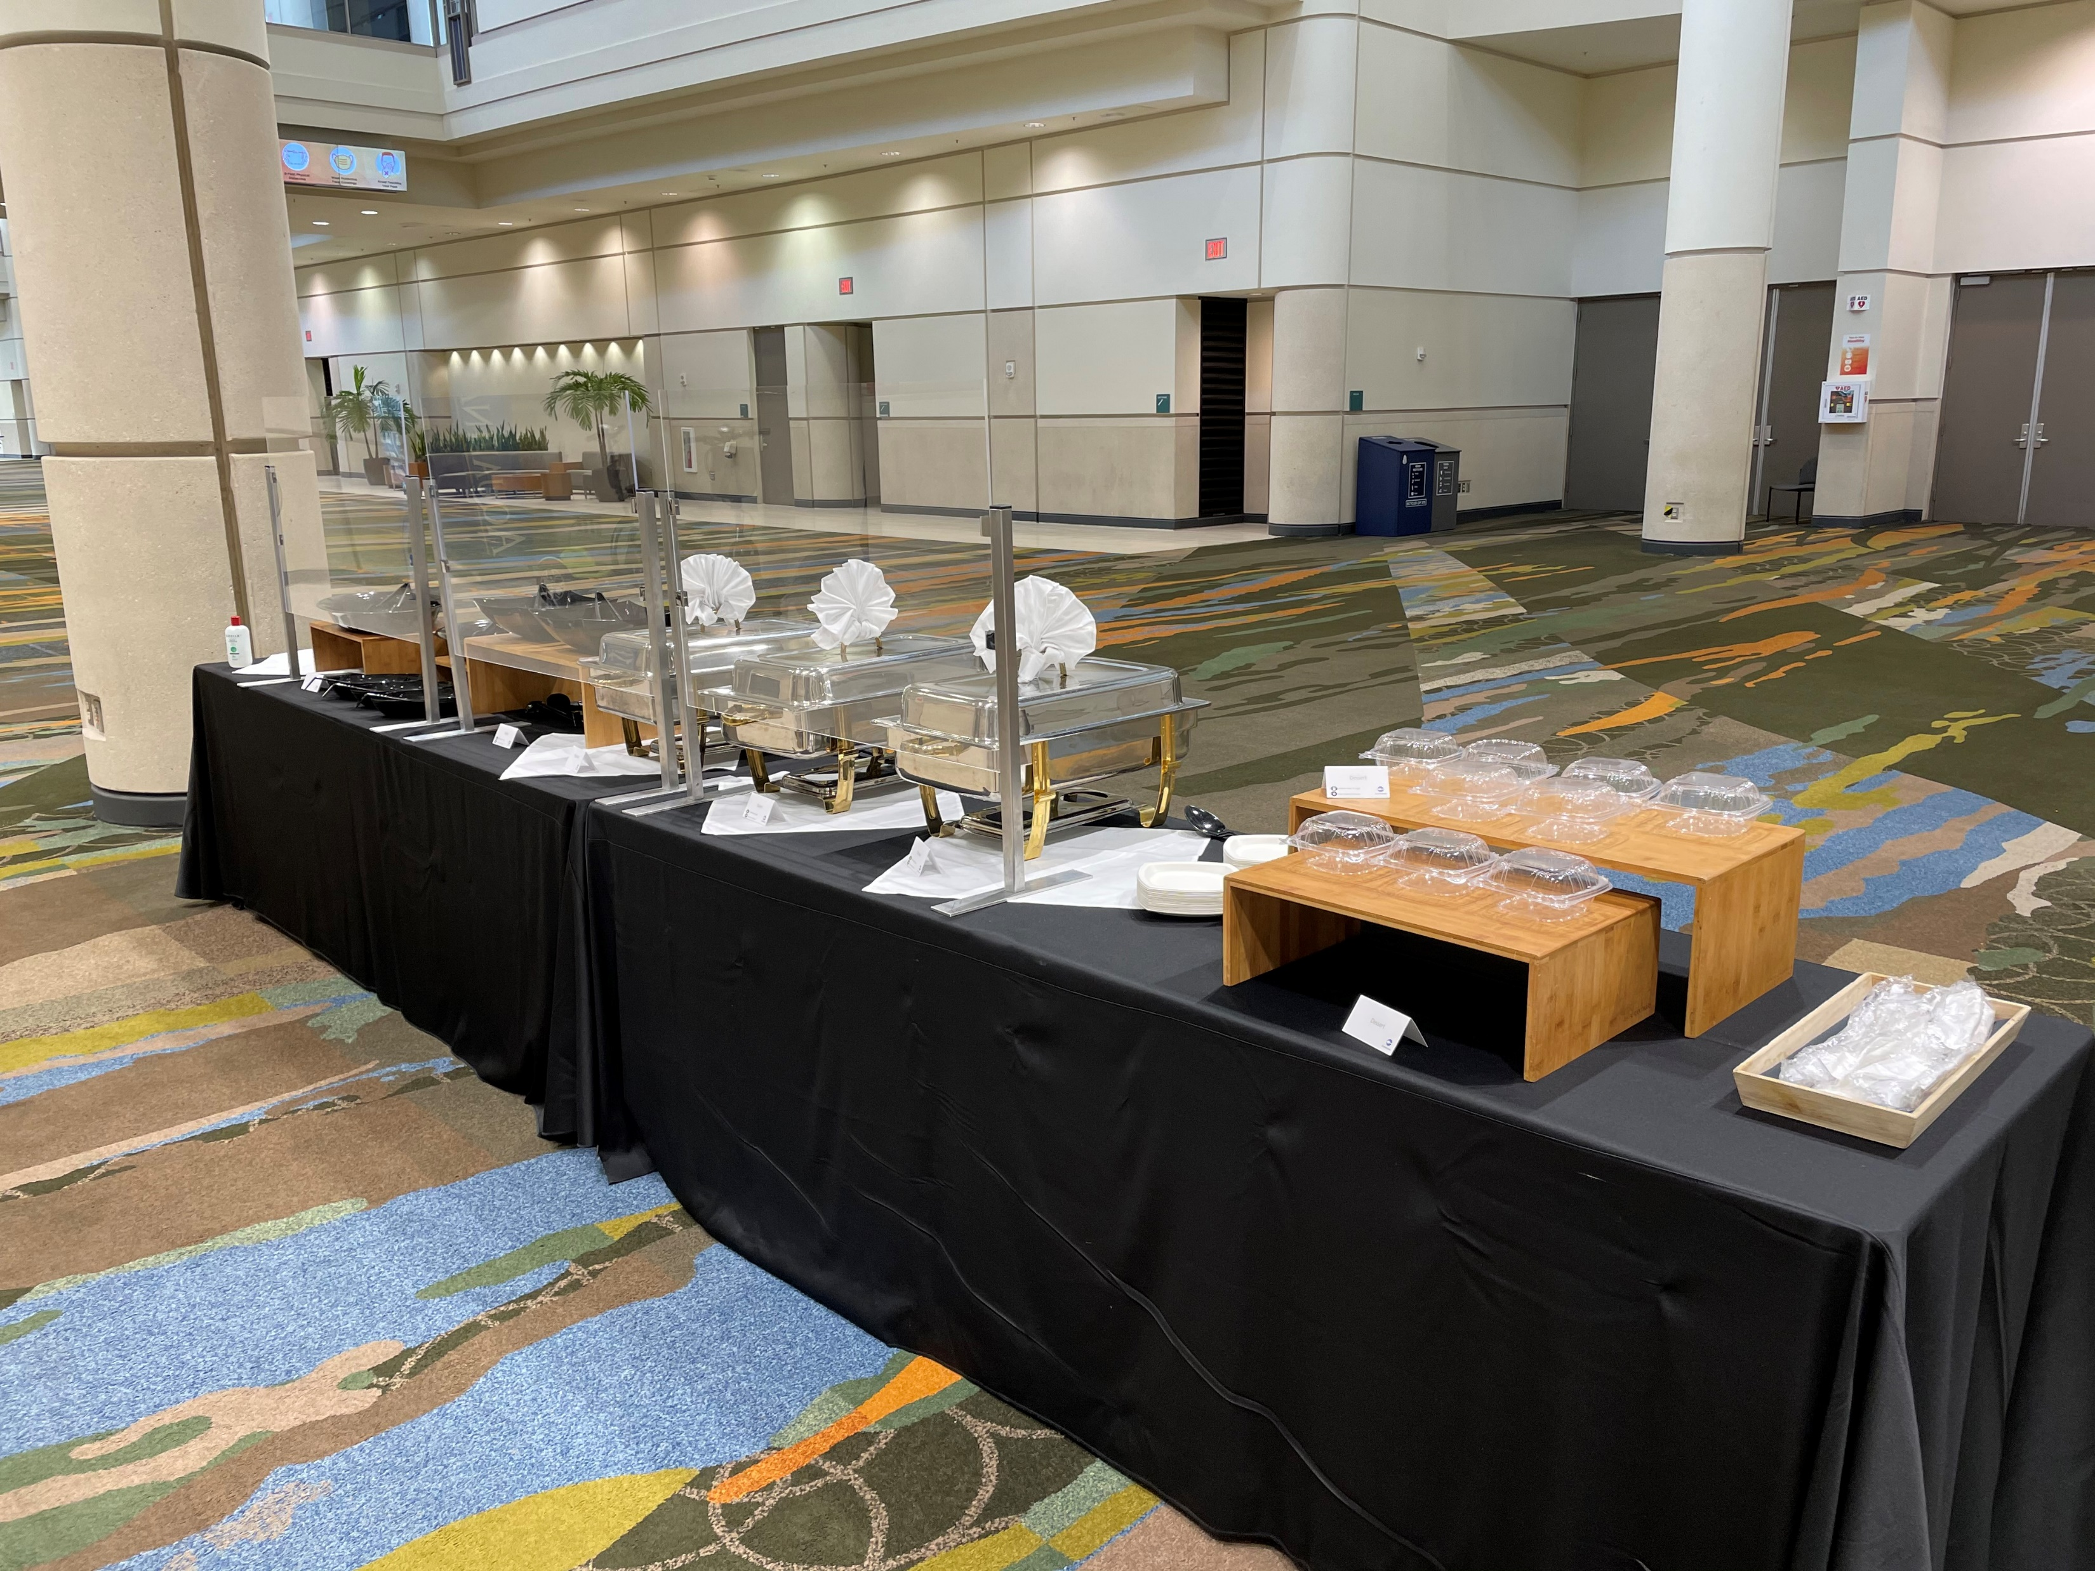
Orlando Hybrid – Food Function Options
Plated meals are served covered with individually packaged condiments rather than shared items. Beverages are also covered. Each table is limited to 4 people to allow for adequate spacing (normally 10-11 people).
Buffet meals are also available but individuals are no longer allowed to serve their own plates. Masked and gloved catered staff will stand behind a plexiglass barrier. Food will be plated per attendee request and handed to the attendee at the end of the buffet line.
Prepackaged meals and snacks are also a popular option. All items are individually prepacked in separate containers.
Touchless payment options will be available.

Slide 13
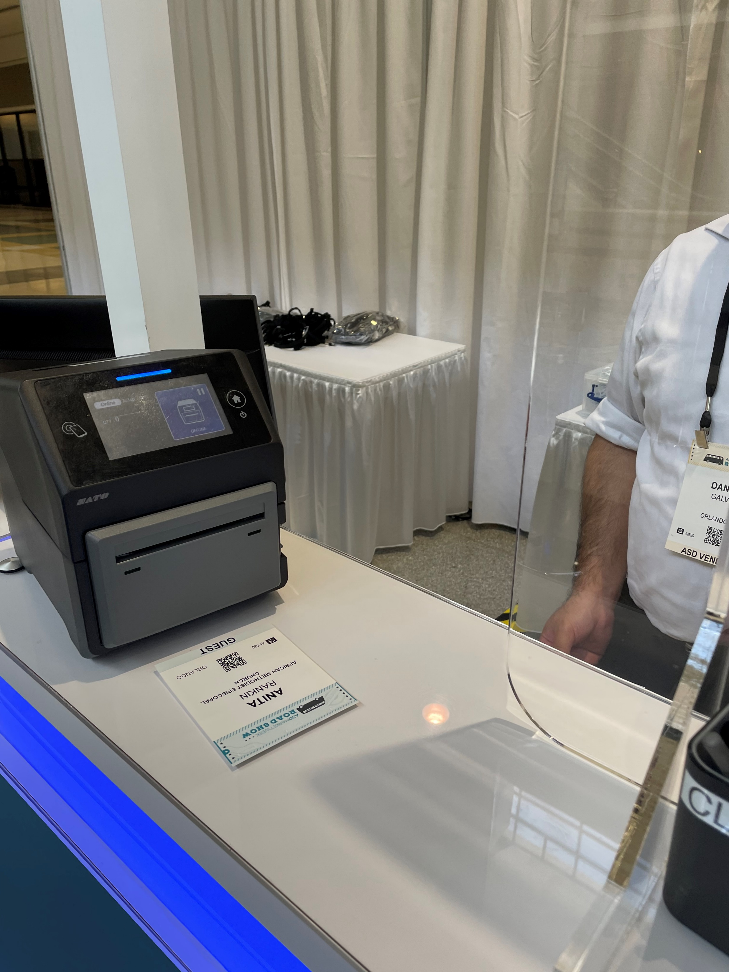
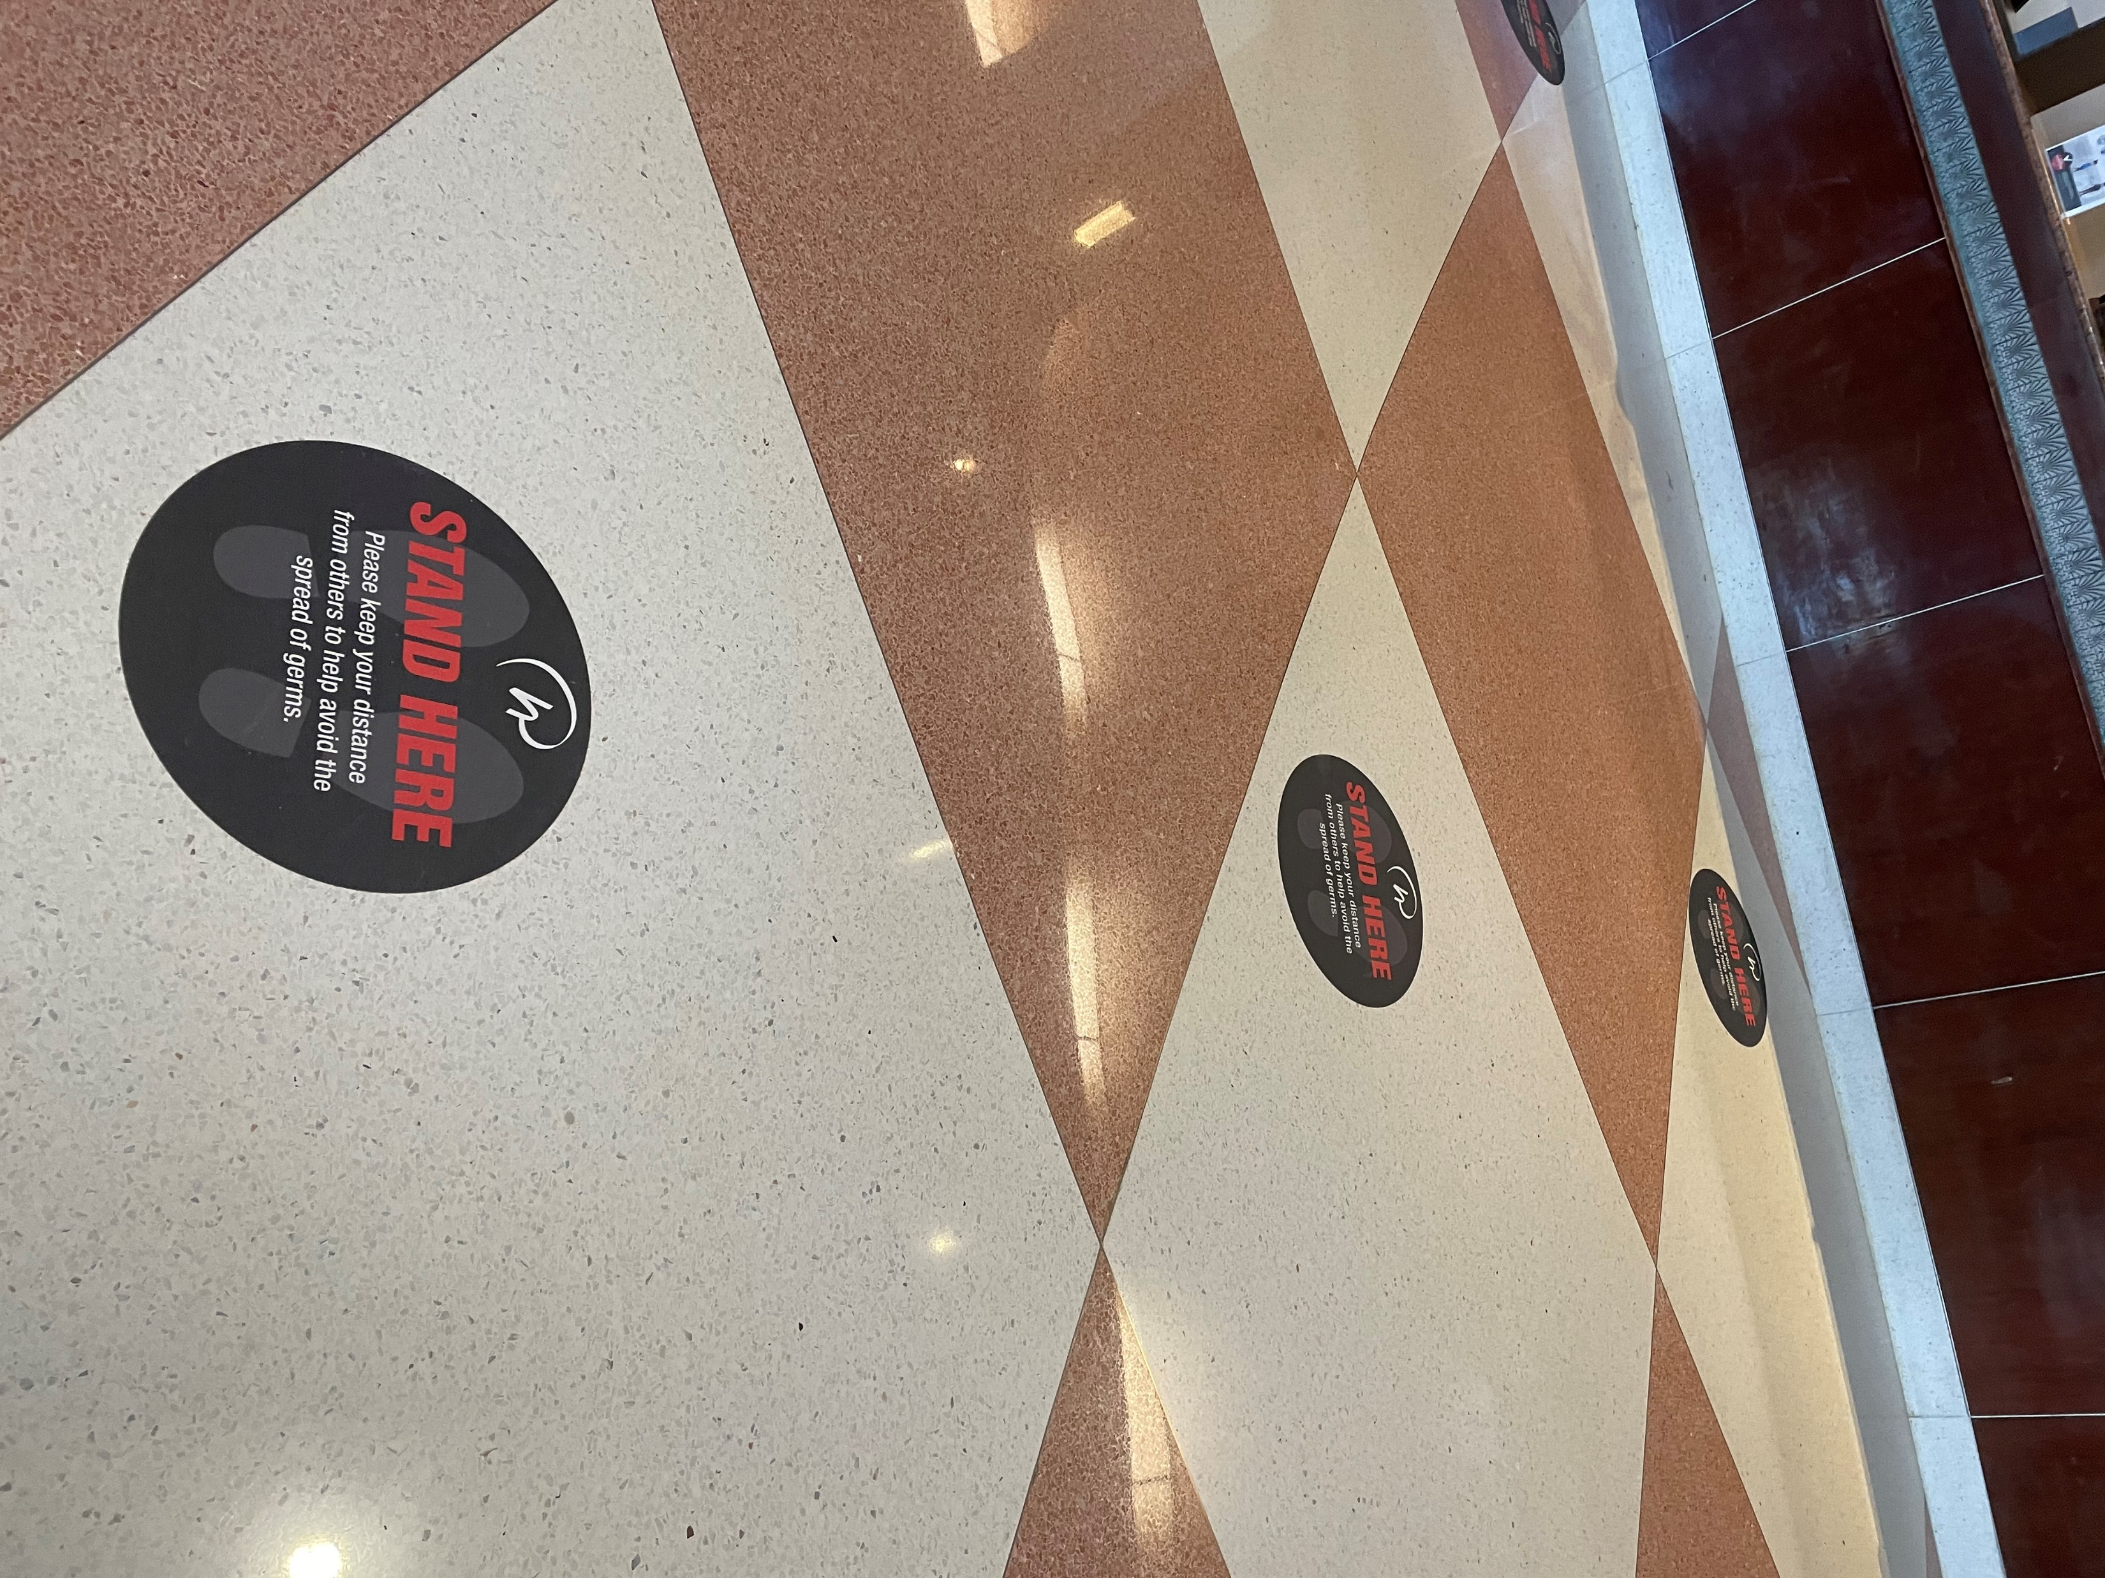
Orlando Hybrid - Registration
Badge review and approval in advance to limit on-site changes
Plexiglass barriers at each counter
Physical distancing in line
Scheduled times for District pickup to limit crowds and lines

Slide 14
Orlando Hybrid – Committee Meetings
Revisions, Rules and Credentials Committees will meet in person, in Orlando as scheduled.
Committee members in the South Africa site will join their committee via Zoom.
Committee meeting rooms will be set socially distant in assigned seats. All applicable Covid-19 protocols will be followed.
Revisions: Starts June 30, 2021
Rules: July 3-5, 2021
Credentials: July 3-5, 2021

Slide 15
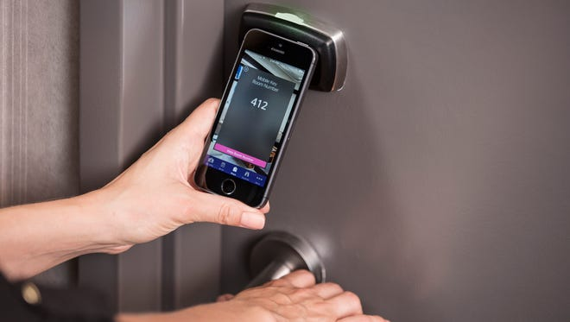
Orlando Hybrid - Hotels
Keyless entry using your cell phone
Limited valet parking at some hotels, self parking is recommended
Room service only available at some hotels
Housekeeping available upon request
Temperature screenings at some hotels
Hand sanitizing stations throughout the properties
Face coverings are required in the common areas of the hotel
Contactless delivery of guest request items

Slide 16
Orlando Hybrid – Vendors
At this time we are recommending there will NOT be vendors at either site.
We recommend a virtual option for vending be considered.

Slide 17
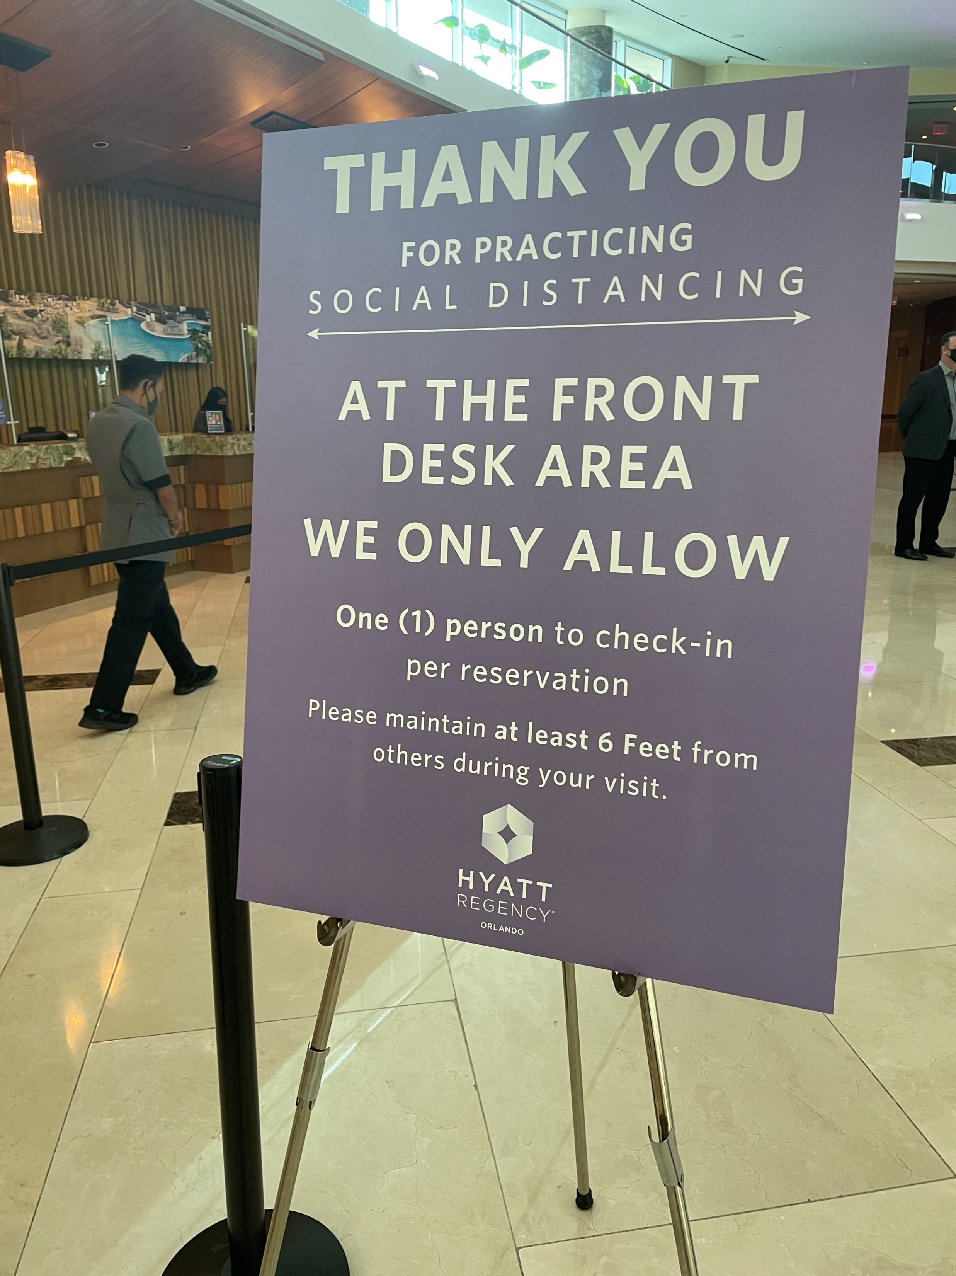

Orlando Hybrid - COVID Protocols
COVID -19 protocols will follow CDC guidelines. We continue to monitor their recommendations and will update as needed. All attendees will acknowledge their understanding of protocols and requirements. Current AME protocols will include:
Proof of full vaccine or acceptable exemption will be required in Orlando. Local requirements will be followed at the selected site in South Africa.
Masks will be required for all attendees two and older
Temperature checks
Daily self checks and other screening measures
Physical and social distancing
One-way entrances and exits to each meeting room

Slide 18
Orlando Hybrid – Medical Support
A Safety Plan has been drafted outlining the safety policies and procedures we will follow during the 51st Quadrennial General Conference. This Plan will be reviewed by a team of doctors and medical professionals at Orlando Health who will certify all approved plans.
A team of medical professionals will be in place at each site – Orlando and South Africa - during the General Conference to manage Covid-19 issues as well as other medical emergencies.

Slide 19
Orlando Hybrid - More Information
For the latest developments as it relates to the General Conference be sure to check the AME Church official website at www.ame-church .com
E-blasts will be sent through the CIO Office
Key information for Delegates/Alternates will also be sent through your Bishop’s Office.
Specific observer questions or assistance with registration & housing can be directed to the call center at 1-833-628-6180 (Monday-Friday, 9:00 AM to 6:00 PM EST) or email support@amec-2020gc.org

Slide 20
~ Stay Tuned ~
We look forward to seeing you in
Orlando and South Africa
Two Cities…One Church

